Slide 1
Week at A Glance for Science
February
6-10
Weather and Climate

Slide 2
February 6-10
S6E4. Obtain, evaluate, and communicate information about how the sun, land, and water affect climate and weather.
a. Analyze and interpret data to compare and contrast the composition of Earth’s atmospheric layers (including the ozone layer) and greenhouse gases.
(Clarification statement: Earth’s atmospheric layers include the troposphere, stratosphere, mesosphere, and thermosphere.)
b. Plan and carry out an investigation to demonstrate how energy from the sun transfers heat to air, land and water at different rates.
(Clarification statement: Heat transfer should include the processes of conduction, convection, and radiation.)
c. Develop a model demonstrating the interaction between unequal heating and the rotation of the Earth that causes local and global wind systems.
d. Construct an explanation of the relationship between air pressure, weather fronts, and air masses and meteorological events such as tornados and thunderstorms.
e. Analyze and interpret weather data to explain the effects of moisture evaporating from the ocean on weather patterns and weather events such as hurricanes.

Slide 3
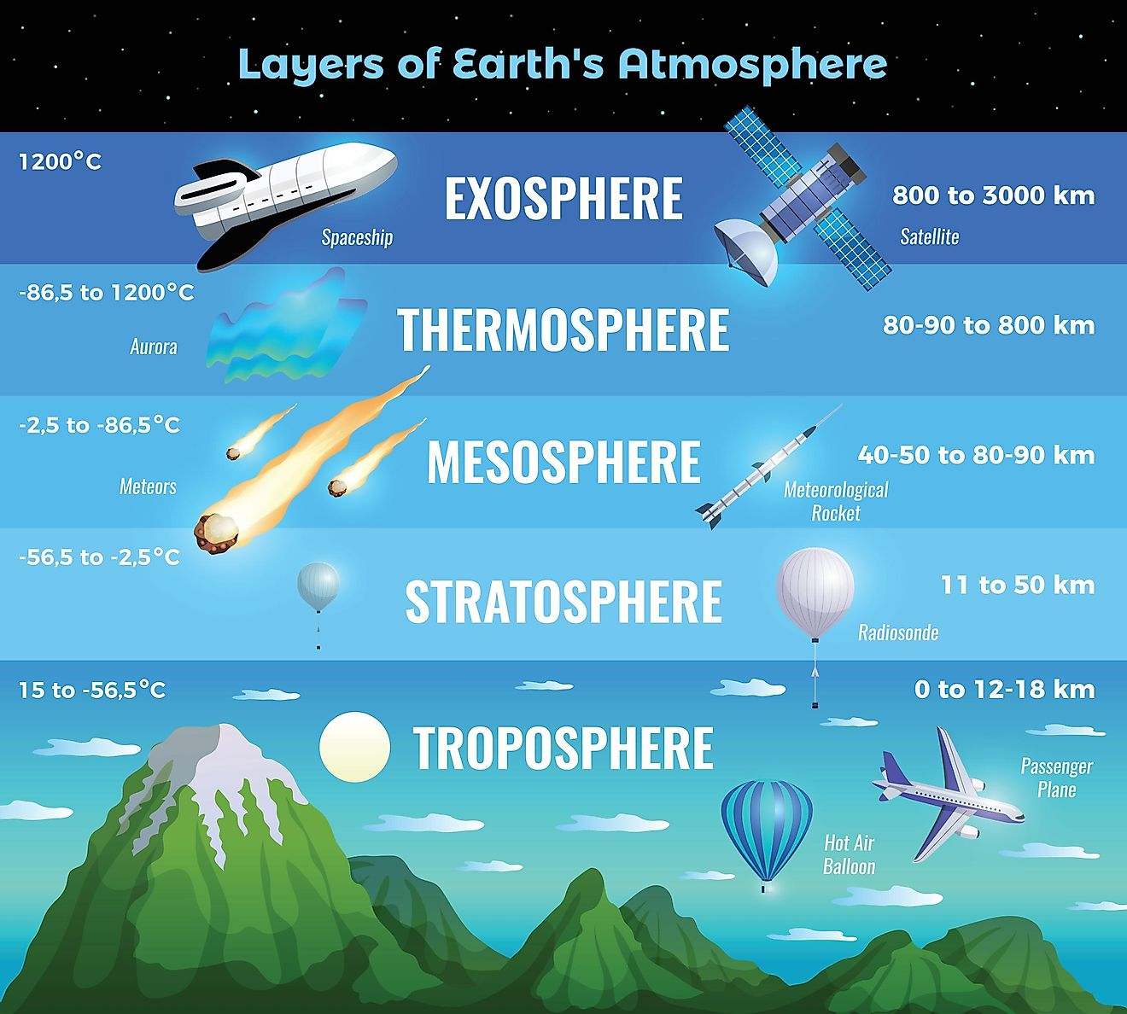

Slide 4
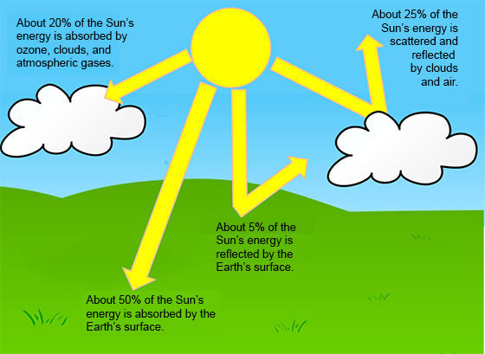

Slide 5
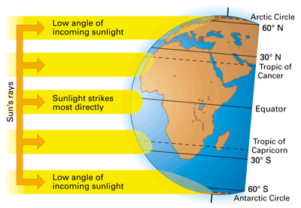

Slide 6
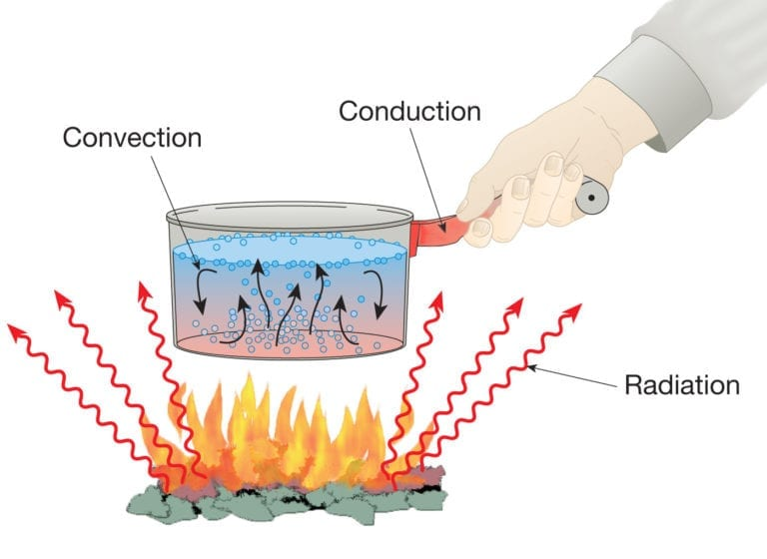

Slide 7
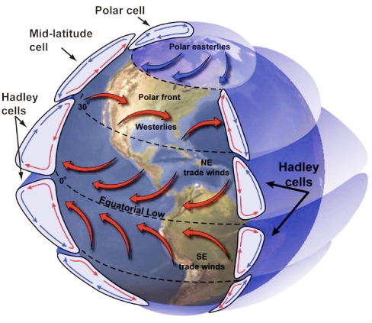
Global Wind Explained
The illustration below portrays the global wind belts, three in each hemisphere. Note that the U.S. lies primarily in the Westerly Wind Belt with prevailing winds from the west. Each of these wind belts represents a "cell" that circulates air through the atmosphere from the surface to high altitudes and back again. The cells on either side of the Equator are called Hadley cells and give rise to the Trade Winds at Earth's surface. How do we explain this pattern of global winds and how does it influence precipitation?

Slide 8
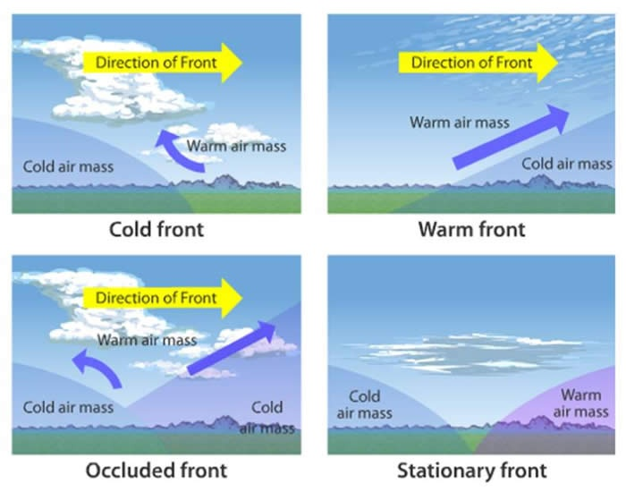

Slide 10
Students will have 15 minutes of Homework each evening.
4 Squares (usually a drawing)
Rock Cycle Puzzle
Workbook Pages
Powerpoint Study Guides
Study Notes or Study Guides
Watch Videos from Week at a Glance

